Slide 1
AP157 Module 2: Supervised Classification
May 25, 2022

Slide 2
Outline
Example: Hubble classification of galaxies
Supervised Classification Problem
Model Evaluation I: Confusion Matrix
Types of Classification Methods
Generative Classification
Example: k-NN classifier
Discriminative Classification
Example: Decision tree classifier
Model Evaluation II: ROC curve
Lab Assignment: Morphological Classification of Galaxies using Decision Trees

Slide 3
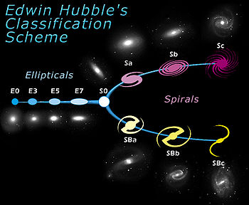
Hubble classification (Hubble sequence)

Slide 4
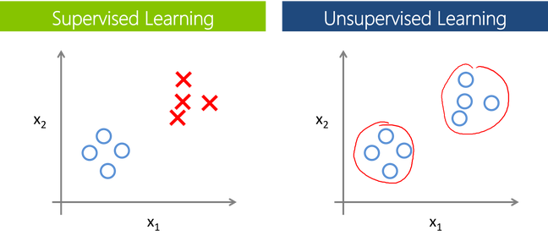
Supervised vs. Unsupervised Classification
Training set is labeled data; assign class labels to new data
Dataset is unlabeled (a.k.a. Clustering)

Slide 5
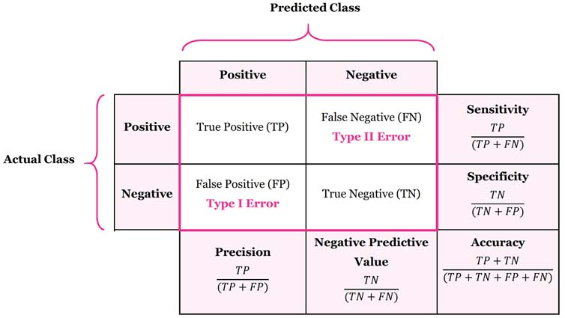
Confusion Matrix

Slide 6
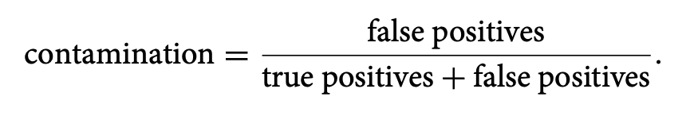
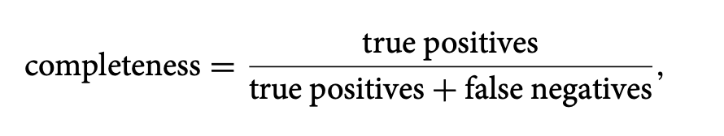
Contamination and Completeness
measures the fraction of detected objects which are mis-classified
= 1 - precision
measures the fraction of total detections identified by our classifier
= sensitivity

Slide 7
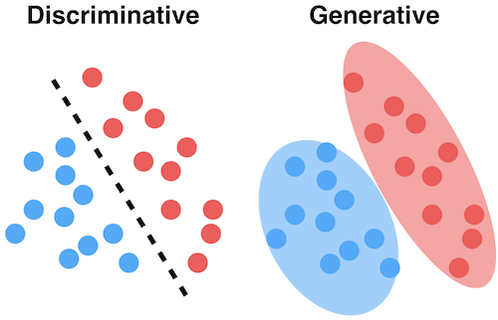
Generative vs. Discriminative Classification
learn what the features in the input are most useful to distinguish between the various possible classes (Ex: k-NN Classifier)
models how a particular class would generate input data (Ex: Decision Tree Classifier)
Source: Medium

Slide 8
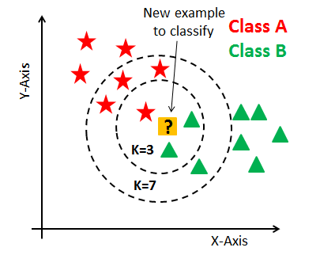
k-Nearest Neighbor (kNN) Classifier
A smoothing parameter, the number of neighbors K , is typically used to regulate the complexity of the classification by acting as a smoothing of the data.
In its simplest form a majority rule classification is adopted, where each of the K points votes on the classification.
Increasing K decreases the variance in the classification but at the expense of an increase in the bias. Choosing K such that it minimizes the classification error rate can be achieved using cross-validation.

Slide 9
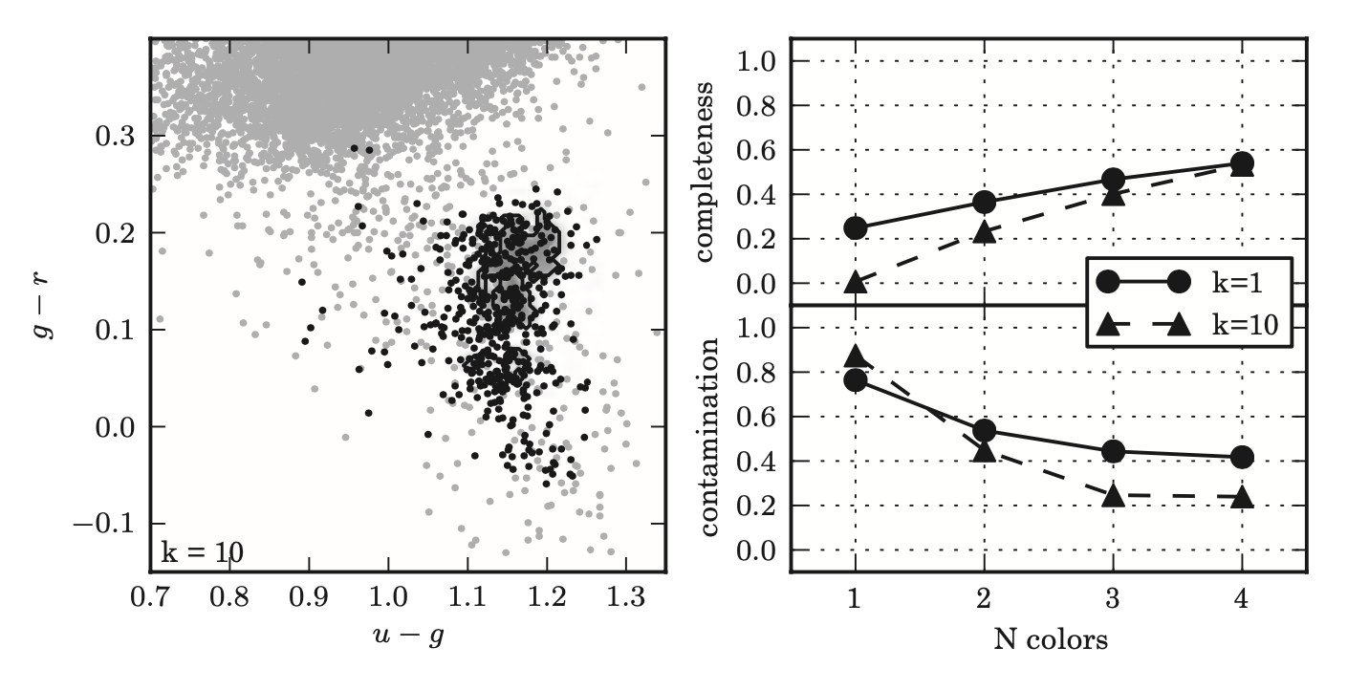
kNN Classifier for RR Lyrae stars
The RR Lyrae stars and main sequence stars occupy a very similar region in u,g,r,i,z color space.
The distributions overlap slightly, which makes the choice of decision boundaries subject to the completeness and contamination trade-off.
Depending on the nature of the problem and the goal of the classification, we may wish to optimize one or the other.
With all four colors and K = 10, K-neighbors classification achieves a completeness of 0.533 and a contamination of 0.240.

Slide 10
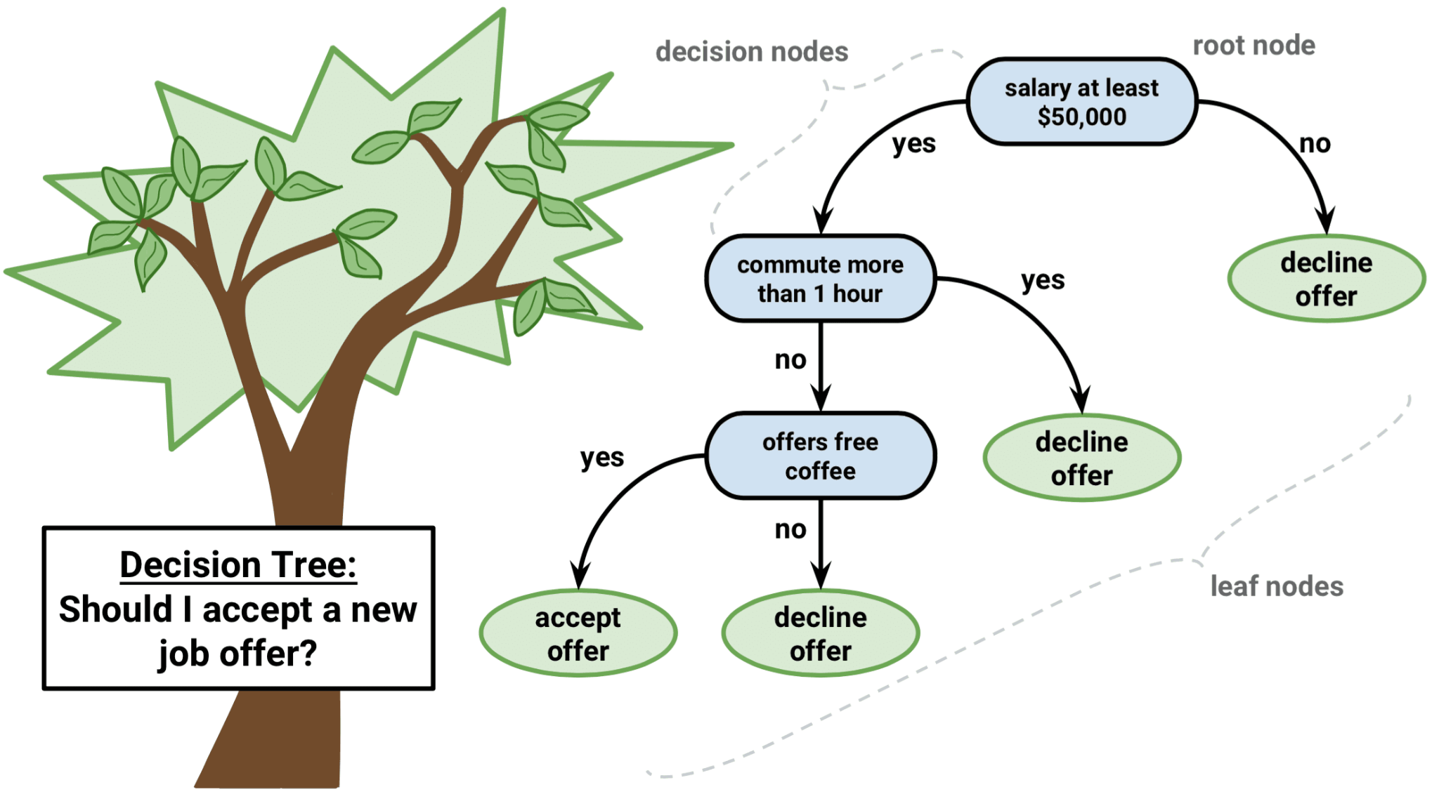
Decision Tree Classifier

Slide 11
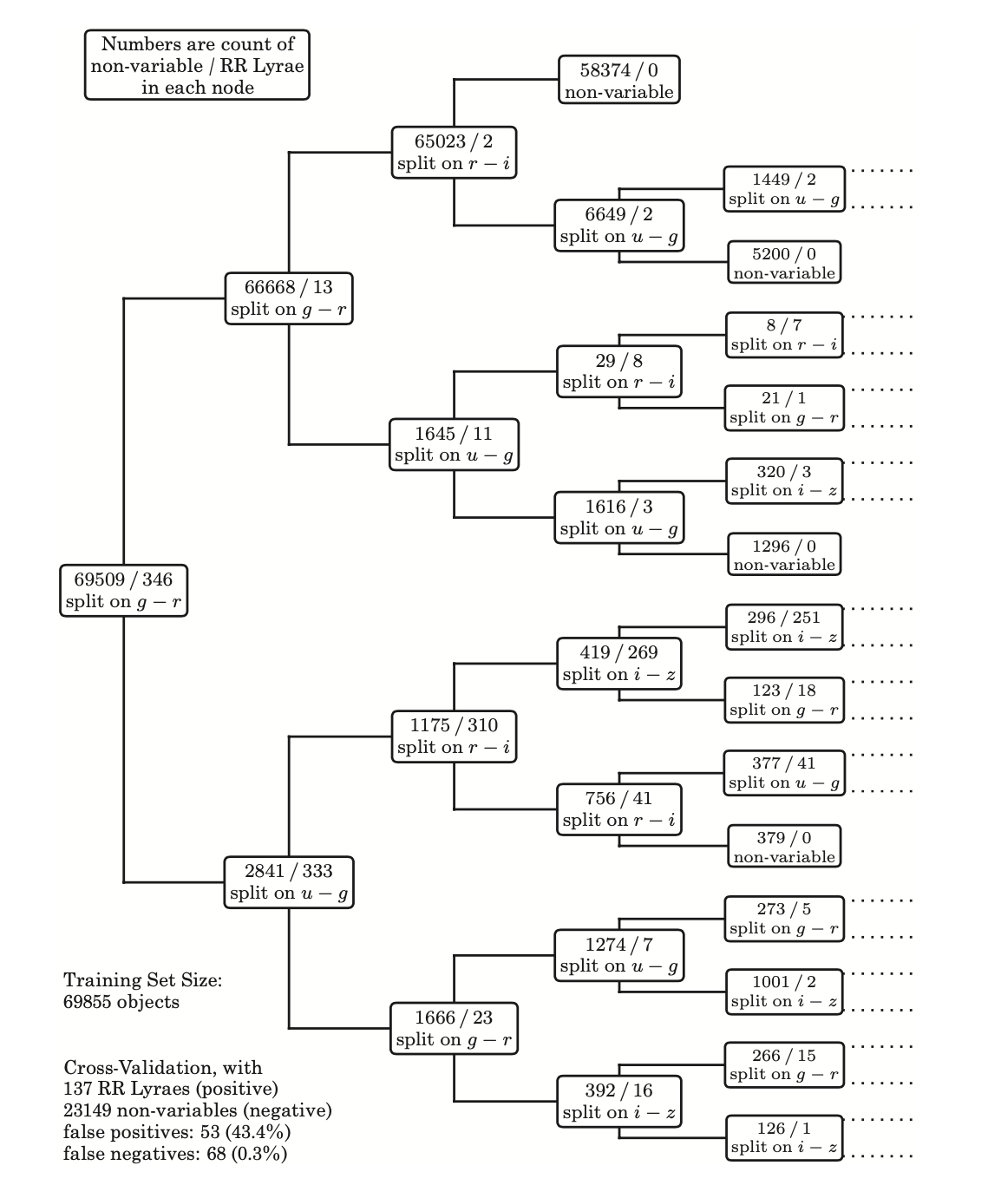
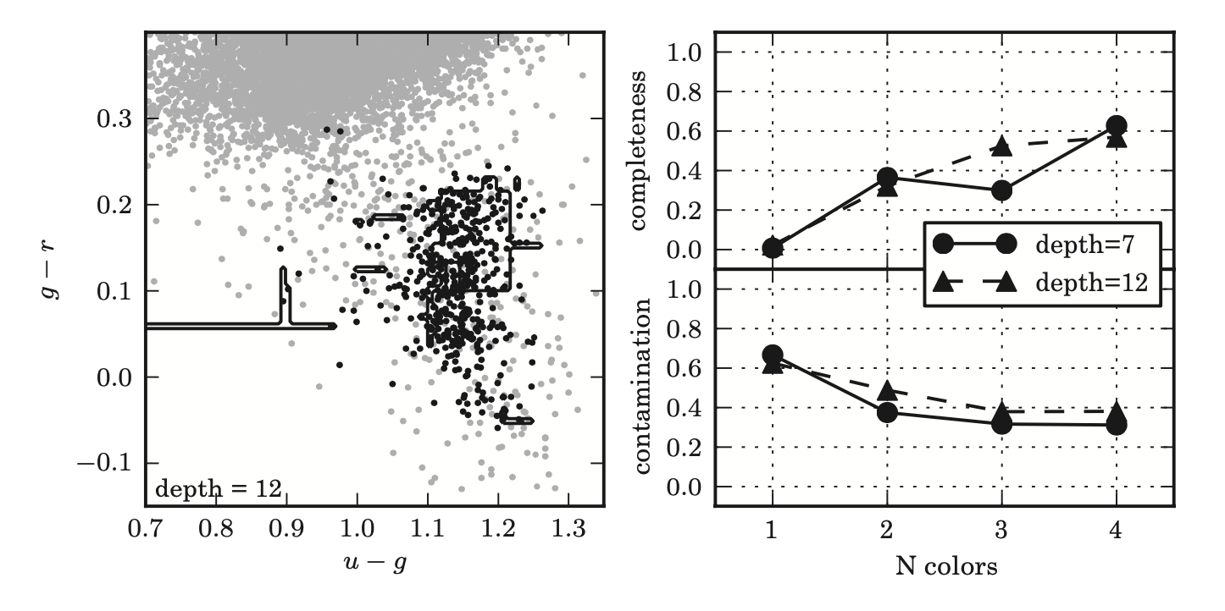
Decision Tree Classifier for RR Lyrae Stars
With all four colors, this decision tree achieves a completeness of 0.569 and a contamination of 0.386.

Slide 12
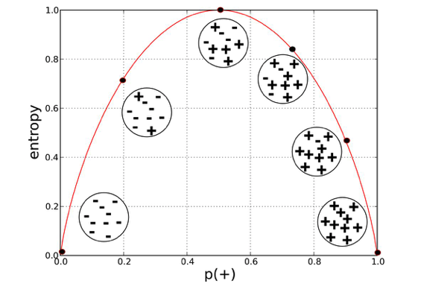
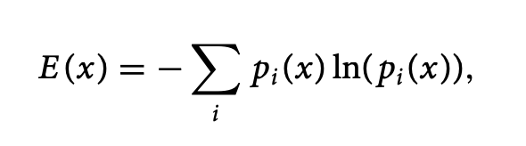
Decision Tree Classifier: Defining the split criteria
Entropy of a dataset x:
where p_i = probability of class i given the training data (percentage of elements with class i)
Entropy is a measure of disorder

Slide 13
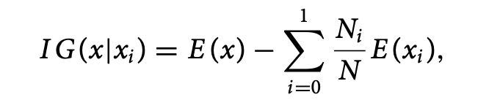
Decision Tree Classifier: Defining the split criteria
Information Gain (IG) for a binary split with i = 0 representing those points below the split threshold and i = 1 for those points above the split threshold:
where N_i is the number of points, x_i, in the ith class, and E (x_ ) is the entropy associated with that class
This is the reduction in entropy due to the partitioning of the data (i.e., the difference between the entropy of the parent node and the sum of entropies of the child nodes)

Slide 14
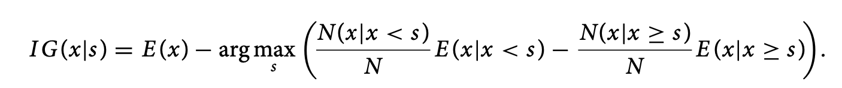
Decision Tree Classifier: Defining the split criteria
The search for the split is undertaken in a greedy fashion where each feature is considered one at a time and the feature that provides the largest information gain is split.
The value of the feature at which to split the data is defined in an analogous manner, whereby we sort the data on feature i and maximize the information gain for a given split point, s:

Slide 15
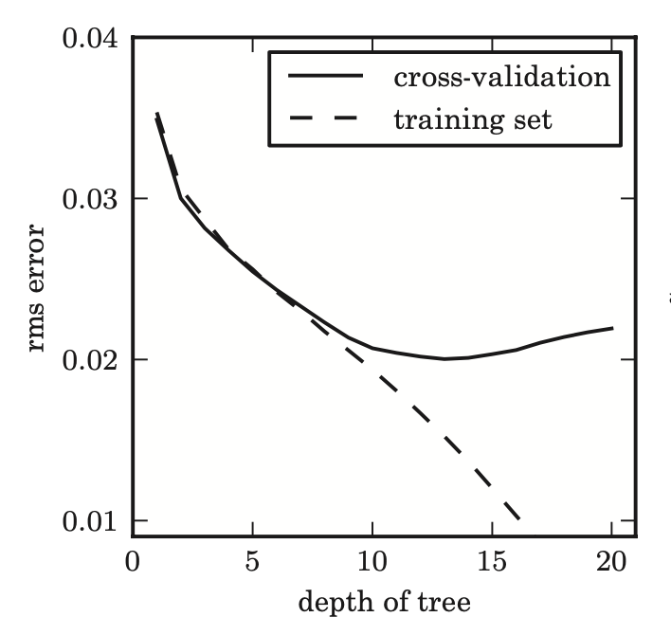
Decision Tree Classifier: Building the tree
A common criterion for stopping the recursion is to cease splitting the nodes when:
either a node contains only one class of object
a split does not improve the information gain or reduce the misclassifications
or, the number of points per node reaches a predefined value
For decision trees the complexity is defined by the number of levels or depth of the tree.
As the depth of the tree increases, the error on the training set will decrease.
At some point, however, the tree will cease to represent the correlations within the data and will reflect the noise within the training set.
We can use cross-validation techniques to optimize the depth of the tree.
For the optimal depth of 13, there are roughly 2^13 ≈ 8200 leaf nodes.

Slide 16
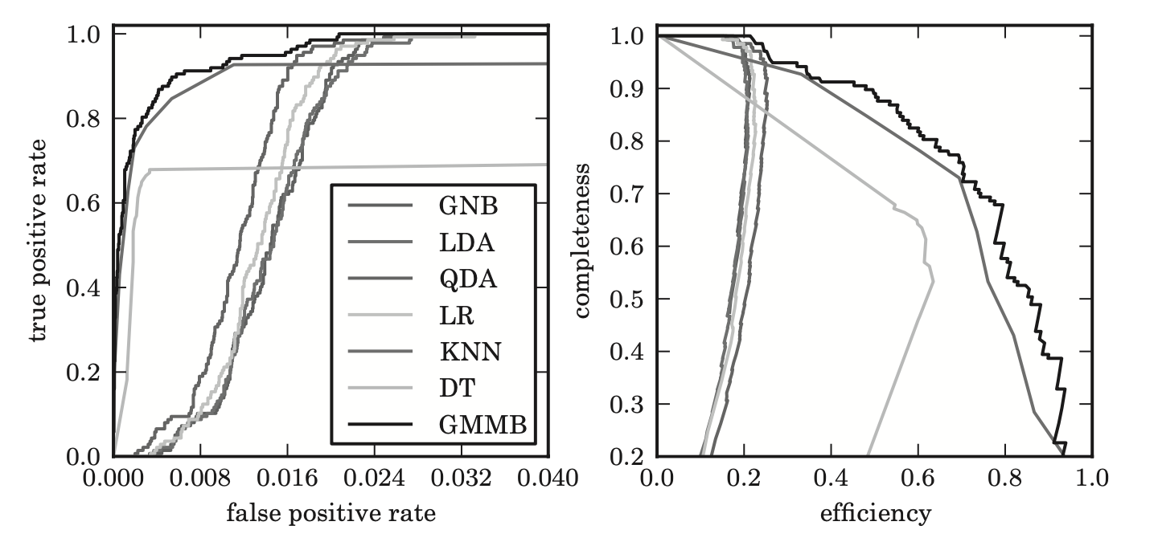
ROC Curves
Receiver Operating Curves (ROC) show true-positive rate as a function of false-positive rate
Completeness vs. Efficiency curves are more appropriate when sources are rare (as in RR Lyraes)
GMM Bayes and kNN are “best” RR Lyrae classifiers in terms of ROC (left)
GMM Bayes is best in completeness vs. efficiency curve.
1 - contamination

Slide 17
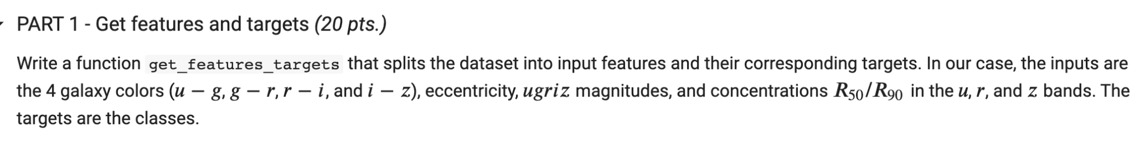
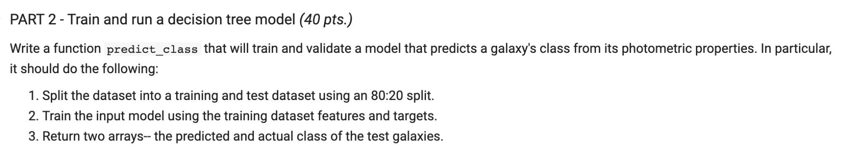
Lab Assignment: Morphological Classification of Galaxies using Decision Trees

Slide 18
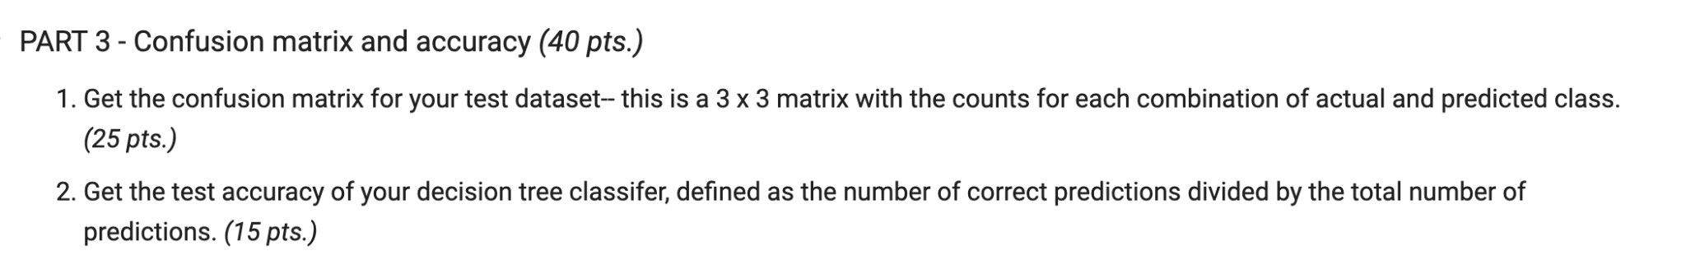
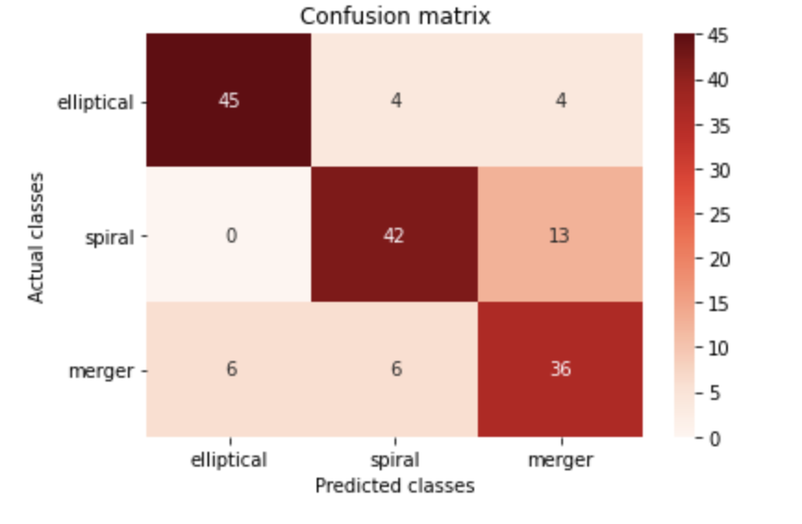
Lab Assignment: Morphological Classification of Galaxies using Decision Trees

